Slide 1
IS8014
Theory & Qualitative IS Research
III Foundations of Qualitative Research

Slide 2
Foundations
Qualitative research is not a single method.
Indeed, there is much debate about how to do qualitative research
Qualitative research refers to a mix of different methods each of which draws on qualitative data
Is it enough that any qualitative data is involved?
Or do we need a more sensitive approach, and try to ensure that a richer appreciation of a phenomenon is achieved?
Or can we require that qualitative researchers adopt either a critical or interpretivist epistemological stance?

Slide 3
Qualitative – Data and Context
There are many different types of qualitative data, but the decision about which kind of data to collect and analyse depends on the nature of the research question and problem
Its useful to review published qualitative research articles so as to explore in more detail what the authors did in terms of
  Problematisation
  Research Question
  Selection of Data – and its Analysis
  Selection of Method
  How they structured the article as a whole

Slide 4
Types of Qualitative Data
Interviews
  Un/Semi/ Structured; Telephone, IM, Face-to-Face
Notes and observations
  Text, Drawings and Sketches, Audio or Video;
Diaries
  Day to Day; Confessional
Documents
  Usually organisational; Text, Audio or Video; Paper, Web
User-generated data
  Data Subject; Text, Audio or Video
  Researcher and Data Subject(s)
  Emails/SMS/IM/Wiki - logs
    Emails/SMS/IM/Wiki/WeChat/etc. - logs

Slide 5
Interviews
The interview is the primary technique for data collection that you are likely to encounter
Rubin and Rubin (2005) say of qualitative interviews: ‘‘[permit] us to see that which is not ordinarily on view and examine that which is looked at but seldom seen’’
But many people treat the qualitative interview with little care and assume it is easy to master
Few people describe their interview techniques in detail
Actually, there are many pitfalls to interviews – things to go wrong

Slide 6
Interview Problems
You may have permission to interview people – but do they want to be interviewed?
  Perhaps its just a waste of their time!
  You usually have limited time.
You don’t really know much about the interviewee(s).
There is little time to create trust – or guanxi with the interviewee(s)
Who selects the interviewees?
  Is there a bias to let you interview the stars or the elite or reliable people?
Language bias and ambiguity – what do they really mean?
Hawthorne effect: your interview technique may contaminate the interview and the data you collect

Slide 7
Goffman’s Dramaturgical Model
Goffman (1959, 1961) developed a theory of social interaction which employs the metaphor of the theatre/drama
It can be applied to the interview, where the interviewer and interviewee are ‘actors’ on the stage, and at the same time the audience
The interviewer has a script (protocol, questions)
Interviewers (and ees) must consider how to dress, how to appear to the other, how to enter and exit the stage
The interviewer needs to show empathy for and interest in the interviewee
The interviewer controls the process (following the protocol) and guides the interviewee back if s/he strays too far

Slide 8
Interview as Drama (Myers and Newman, 2007)
The interviewer decides:
  What to say – and when
  How to say, encourage, support and deal with silence
  How to deal with a shy, bored, tired, boastful, proud interviewee
  How to encourage more detail if the interviewee only says Yes/No
  How to manage interviewees who try to switch roles
  How to kick off – introduction to yourself, to the questions
  How to ask – but to an incomplete script (don’t over prepare)
  To be open to surprises and serendipitous findings
  And how to end – thanks, who else to interview, follow up, confidence, exit

Slide 9
Interview Protocols
A protocol here refers to a plan for the interview
  Which topics, themes, questions you want to ask
  How to start? Open and closed questions?
  Interview or conversation?
  Free-style or very structured?
  There are some similarities with surveys.
You may not get a second chance to ask, so…
How will you record the interview?
  Handwritten notes? iPhone? MP3?
  It is best to transcribe notes asap, or they get forgotten.
How much data? How many interviews?
  We refer to the concept of ‘data saturation’

Slide 10
Data Saturation
The simple idea is that your data is saturated when interviewing more people will not add a significant amount of new data
But different people often talk about the same thing in different ways
So it is not just a matter of finding that the same words are being repeated by multiple interviewees
Instead, you need to analyse the data, in the cultural context, and see if new meanings are being added with each successive interview
In a recent study (Davison et al., 2021) we interviewed 31 people who work in the logistics area of a local HK warehouse (of a global retail firm)

Slide 11
Interview Protocol Example (HK Logistics) I
Demographics - D
D1 Can you briefly describe your routine duties?
D2 What is your position in the company?
D3 How long have you been working here?
About the system - S
S1 Which system do you need to use on a regular basis at work?
S2 What is the main purpose of the system (briefly describe the system)?
S3 How does this system support your work?
S4 Does the organization need this system? Why?
S5 How is the system useful for managing the company?

Slide 12
Interview Protocol Example (HK Logistics) II
About the difficulties of the system for the employee – DS
DS1 Do you have any difficulties with using this system? Why?
DS2 Which of these difficulties is the one that gives you the most barriers? Why?
DS3 Does the system have any deficiencies? Why?
DS4 Do you think the system makes the work more difficult for other colleagues? Why?
About the difficulties of working – DW
DW1 Do you have any difficulties in working? Why?
DW2 What are the factors that cause these difficulties? Why?
DW3 Do you think the difficulties come from human factors or the system’s deficiency? Why?

Slide 13
Interview Protocol Example (HK Logistics) III
About employees’ attitude toward this system – ATT
ATT1 To what extent do you like the system? (Please score out of 10) Why?
ATT2 To what extent do you feel that the system provides adequate functionality given the work that needs to be done?
About change and workarounds – CHG
CHG1 In what aspects do you want the system to change (to be improved)?
CHG2 If the company can’t implement the changes in the near future, will you resist or give up using the current system? Why?
CHG3 What workarounds do you think you can use / create? What are the outcomes?

Slide 14
Interview Protocol Example (HK Logistics) IV
Social Media - SM
SM1 Do you use social media (e.g. WeChat, WhatsApp, etc.) for work purposes?
SM2 If so, please describe your usage.
SM3 To what extent does social media usage impact (positively or negatively) the way you use the “system”?
SM4 Do you have any comments about using social media for work?
Comments on IT policy – CM
CM1 Do you think the IT on-job training for employees is enough? If not, in what areas?
CM2 Do you think the Information Sharing in the company is enough? If not, in what areas?
CM3 Do you think the current IT policy and planning require improvements? Why (and in what areas) or why not?

Slide 15
Notes and Observations
In field research, we often encounter interesting situations
  Conversations with data subjects
  Watching and reflecting how people behave in different situations
  Our own internal thoughts and interpretations
These unplanned, unscripted events need to be documented carefully, so that we can refer back to them later.
It is important to be aware of the ‘data’ around us and to record them
  The interesting facts, happenings, people, behaviours
A paper notebook is most practical, unless you want to dictate
  Drawings and sketches as well as text
A camera could also be valuable
You need to be prepared for the unexpected
  Some people are not comfortable being recorded, but it is OK to make notes.

Slide 16
Diaries
Diaries can provide a useful subjective account
They are normally written/kept by research subjects, who can be instructed to write down selected behaviours or impressions
For instance, if we are investigating data privacy violations, we could ask people in the IT department to document each time they are asked to release private data, together with some details (nature of request, rank of requester, decision taken, etc.) – in order to assess actual privacy practices.
Confessional diaries are kept by the researcher
  Very detailed notes about everything that you do on a project
  Self-reflections, questions, doubts
  Schultze (2000)

Slide 17
Documents
Corporate documentation is invaluable, especially in case studies where there is a need to build up a picture of organisational values.
Documents may include strategic plans, business processes, standard templates, training manuals, internal telephone books.
Documents may be paper or online (web). They may be for internal or external use, for customers, clients, consultants or employees.
Documents can include data that you would not think to ask about. So reading them carefully can help you to ask the right questions.

Slide 18
User-Generated Data
There are many potentially-useful forms of user-generated data
Many of them are private and confidential, but it is possible to access them if you ask for permission.
In my study of KS practices in Beijing, I was able to access one month’s IM data from a power user.
We analysed that data and found that 80% was for work purposes (i.e. not just social chatting), esp. for knowledge sharing and coordination work.
Some UGD may be contaminated, so select it carefully
What other kinds of user-generated data can you think of, and what could we do with them?

Slide 19
Data Coding & Sources
Organising data so that it can be analysed
Looking for thematic patterns in data so as to identify theoretical constructs, as well as practical examples to illustrate existing theory
Interview transcripts are a major source of data
Corporate documentation is possible
User generated texts are a good source, including diaries.
There is software for qualitative data coding/analysis, e.g. NVivo.

Slide 20
What to Look For?
Patterns, themes, frequencies, repetition
Can you identify regularities or common features?
Are some themes dominant?
Does the use of language tell us something?
Can we analyse the actual text for hidden or clear meanings?
Compare across documents/interviews (intertextuality)

Slide 21
Themes
Organising data according to patterns or themes that can be identified
  High-level (Meta) themes
  Lower-level concepts, patterns
The themes may emerge from the data, inductively, or may be identified a priori in the literature, deductively, or emerge from the data and be corroborated by literature, abductively
The more consistent data we can get from multiple sources (people) the better we can triangulate our findings

Slide 22
The Mechanics of Data Coding
Open Coding
  Read through all the data and look for themes and patterns
  There is a need for constant comparison of data and themes
Selective Coding
  Focus on developing ‘core categories’ or major groups of content
  There needs to be enough evidence for each core category
Theoretical Coding
  Consider how the core categories are related to each other – as constructs
  Develop theoretical propositions that link the constructs together

Slide 23
An Example of Data Coding
In the next few slides, I show some examples of the coding that I applied in the project whose interview questions I mentioned above
I am investigating how employees coordinate the ways in which they work around an enterprise system
I focus on two key themes:
  Coordination
  Persistence
Ultimately, I am interesting in developing theoretical conjectures
I follow the data coding guidelines of Gioia et al. (2013)

Slide 24
First Order Concepts I
Communicate Workarounds Among Colleagues
  We communicate the workarounds with other colleagues, so everybody knows that if we face these problems, we can use Excel as a supplementary workaround to support our work. (JA)
  We communicate within our groups for workarounds. We discuss how can we avoid the mistakes and use Excel to undertake manual work. (IL)
Develop Consensus About Workaround Application
  Workarounds are the result of consensus among all of us. (CH)
  This workaround has been adopted across several departments because logistics are critical to many different departments. We all agreed that if we have problems, we will use this workaround. (DW)

Slide 25
First Order Concepts II
Discuss Workaround Design and Improvement
  We decide the workaround with our team. When there is a problem, we will have a meeting to discuss how to tackle the problem and minimize the impact. If the workaround provides a good solution we will try to execute it. If the impact is not good, we will see how to improve it. (IY)
  All super users are doing testing together and we know the problems, so we discuss them together, create workarounds and use them as part of our standard work practice. (PC)
Standardise and Document Workarounds
  After information gathering and sorting in Excel, we can accomplish the arrangement of delivery, the forecasting of the number of delivery vans needed. Those processes are a workaround designed by ourselves. … If we employ a new colleague, we have standard operating procedures for workarounds, so even if I leave the company my colleague can accomplish these tasks. (MS)
  We have a training manual for workarounds that we study individually (TC)

Slide 26
First Order Concepts III
Regular Use of Workarounds
  We do workarounds every day because Navision cannot fit our work process needs (NF)
  Navision does not provide for the delivery of goods. Therefore we use Excel to manage the delivery process. Without Excel, there is no way to undertake the delivery of goods (MS)
  Every day we do our work on Excel not in Navision. Excel supports many workarounds because Navision cannot support those functions. We have reported this situation to our superiors for 1.5 years but nothing has changed and so this workaround has become a central component in our regular work process (LT)

Slide 27
Second Order Themes
Communicate Workarounds Among Colleagues > Sharing Knowledge About Workarounds
Develop Consensus About Workaround Application > Consensus Building
Discuss Workaround Design and Development > Co-design Workarounds
Standardise and Document Workarounds > Formalise Workarounds
Regular Use of Workarounds > Continuous Usage of Workarounds

Slide 28
Aggregate Dimensions
Coordination of Workarounds
  Communicate Workarounds Among Colleagues > Sharing Knowledge About Workarounds
  Develop Consensus About Workaround Application > Consensus Building
  Discuss Workaround Design and Development > Co-design Workarounds
Persistent Workarounds
  Standardise and Document Workarounds > Formalise Workarounds
  Regular Use of Workarounds > Continuous Usage of Workarounds

Slide 29
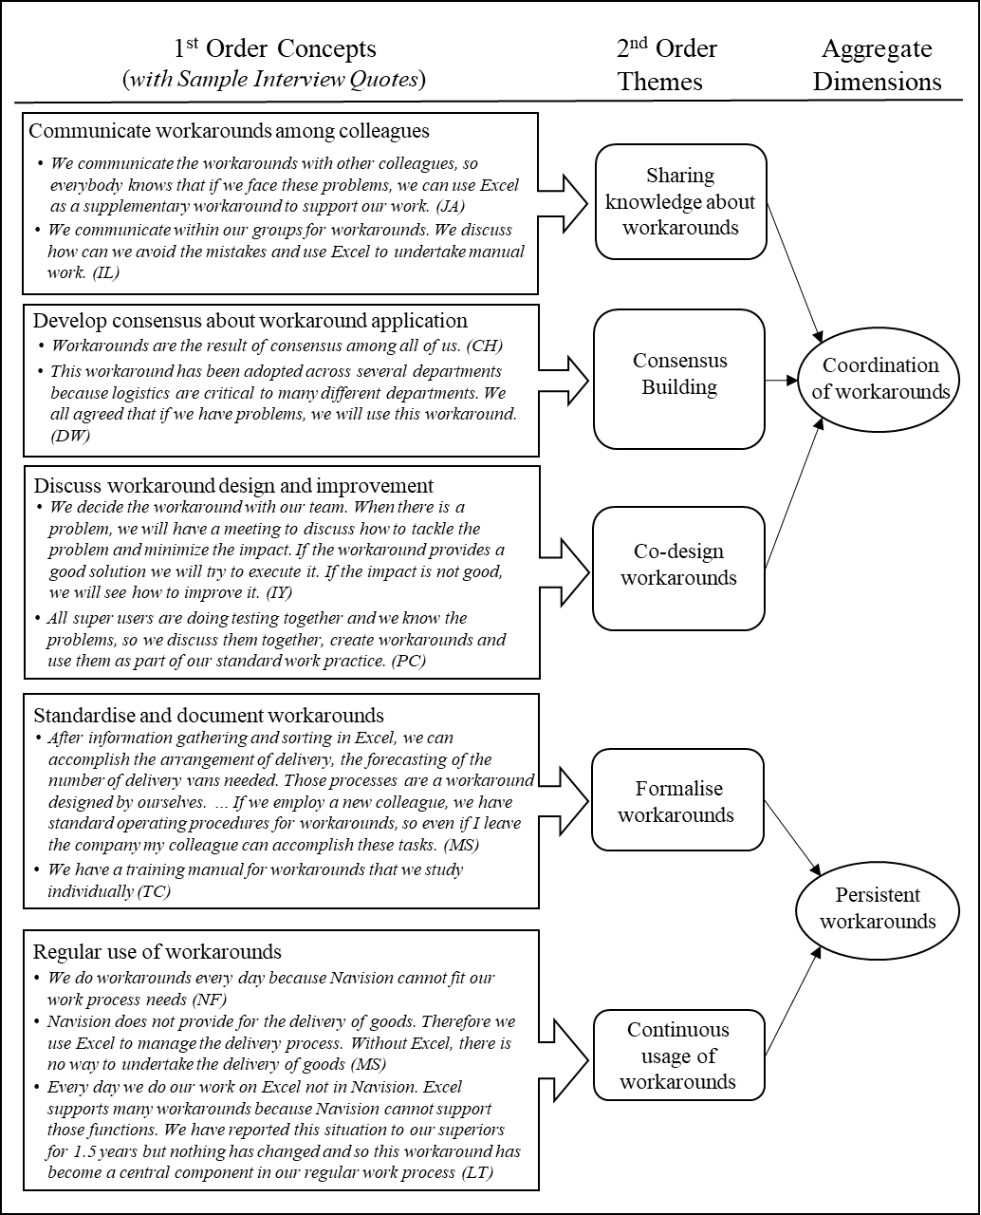

Slide 30
Translations
The literature that we draw on when we theorise is usually published in English
  The theories, models, constructs, variables, etc. are all explained and justified in English
However, our data may or may not be in English
  It might be written Chinese documents
  It might be audio-taped Cantonese/Mandarin/xxx conversations
The data may need to be translated at some stage
But translating ALL the data is a major headache!
GAI may help, but there are ethical issues there

Slide 31
Translations – Personal Experience
A lot of the data that I collect is interview data
  Some is in Cantonese, some in Mandarin, some in English
Transcribing the data from audio to text is very time consuming
  One hour of audio recording requires one day to transcribe
  Translating the data requires more time, but much of the data is not very useful
So it is better to transcribe first, then to read in the original and select segments for translation
  Doing this requires a high level of familiarity with the research topics, theory, constructs, etc., and with the kinds of data I am looking for
  GAI has problems that need to be considered carefully

Slide 32
If You Analyse Qualitative Data Carefully
You may be able to ground a theory out of the data
You may see a new way to organise work, people, processes
You may identify new constructs that were not previously reported in the literature
  In the study I mentioned, we identified new forms of behavior not previously mentioned or discussed in the literature
Qualitative case studies have been used for theory building, where the case data supports the theory.

Slide 33
Methods – and Techniques for Qualitative Data Research
Case Study
Ethnography
Action Research
Grounded Theory
Hermeneutic Interpretation
But note that qualitative researchers often combine methods and techniques, e.g. case study + action research; grounded theory + case study

Slide 34
Case Study
A case study is an empirical inquiry that:
  investigates a contemporary phenomenon within its real-life context, especially when
  the boundaries between phenomenon and context are not clearly evident (Yin, 2003)
The case study is the most common research method in IS that draws on qualitative data, though it may also use quantitative data
Case study write-ups must include quotations from the data subjects who were studied in order to present a narrative of a situation
Case studies can be positivist, interpretivist, or critical. They may draw on both qualitative and quantitative data

Slide 35
Ethnography
An ethnographer is required to spend a significant amount of time in the field.
Ethnographers immerse themselves in the lives of the people they study and seek to place the phenomena studied in their social and cultural context.
Ethnographies are used to study the development of systems and work practices/processes.
  For instance, a study of a community and the way the members of that community use technology to achieve some purpose
Cyber-ethnographies do the same thing in online environments such as online communities of practice

Slide 36
Action Research
Action Research involves the combination of theory and practice “through change and reflection in an immediate problematic situation within a mutually acceptable ethical framework” (Avison et al. 1999)
AR requires researchers to have the dual intention of both improving practice and contributing to theory and knowledge within and beyond the immediate confines of the project
AR is an intensive form of research, with extensive time spent with organizational clients in in-depth interactions
But there are close to 20 variants of AR, each offering subtle differences in execution and intent

Slide 37
Grounded Theory Method
… is a research method that seeks to develop theory that is grounded in data systematically gathered and analyzed.
… is "an inductive theory discovery methodology that allows the researcher to develop a theoretical account of the general features of a topic while simultaneously grounding the account in empirical observations or data" (Martin & Turner, 1986)
But this is an oversimplification: there are three different variants of GT: Glaserian, Straussian, and Constructivist

Slide 38
Hermeneutic Interpretation
Hermeneutics is the art of interpretation and so can be applied within the practice of other methods such as case studies and action research
  It involves making sense of texts
  What do people mean when they write or say something?
Central concepts include:
  The dialectic between the understanding of the text as a whole and the interpretation of its parts
  When we attempt to understand a text we always have some prior knowledge or expectation of what the text is about. This prejudices our interpretation. Prejudice itself is rooted in our culture, our education system, our values.
  As time passes, so a temporal distance opens up between the meaning intended by the author of the text and the meaning today of the reader
  The reader engages with the text so as to appropriate meaning
We will look at an instance of hermeneutic interpretation in a later class

Slide 39
Bødker, M., Gimpel, G. and Hedman, J. (2014) Time-out/Time-in: The Dynamics of Everyday Experiential Computing Devices, Information Systems Journal, 24, 2, 143-166.
Malaurent, J. and Karanasios, S. (2019) Learning from Workaround Practices: The Challenge of Enterprise System Implementations in Multinational Corporations, Information Systems Journal 30, 4, 639-663.
How did the authors motivate each paper? Are the papers interesting?
Does the motivation make sense to you? How could you have motivated it differently? Was the problematisation effective, and effectively communicated to readers?
What was the role of theory in each paper? Does the theory fit the research problem?
What are the most difficult aspects of these two papers for you as a reader? Why?

Slide 40
Readings for Next Week
LePine, J.A. & King, A.W. (2010) Editors' Comments: Developing Novel Theoretical Insight from Reviews of Existing Theory and Research, Academy of Management Review 35, 4, 506-509.
Tarafdar, M., Cooper, C.L. and Stich, J.F. (2019) The Technostress Trifecta: Techno Eustress, Techno Distress and Design: Theoretical directions and an agenda for research, Information Systems Journal 29, 1, 6-42.
Webster, J., & Watson, R.T. (2002) Analyzing the Past to Prepare for the Future: Writing a Literature Review. MIS Quarterly 26, 2, xiii-xxiii.

Slide 41
Questions for Next Week
What are the primary suggestions of Webster and Watson (2002) for the undertaking of literature reviews?
Do they make any suggestions that you disagree with? Why?
Evaluate Tarafdar et al. (2019) with reference to the ideas/principles in Webster and Watson 2002).

