Slide 1
IS6602 V: Methods III
Tools, Techniques and Theories in Requirements Analysis

Slide 2
The Green Light
Once you have an agreement with the client on how to proceed, you can start to collect data in order to determine the exact requirements
This phase will lead towards action planning
Now is the time to decide which questions to ask and how to ask them
You want to get answers that are useful, understandable and comparable

Slide 3
For Example
Lets assume that we want to find out if the employees are satisfied with their current IT
  Which IT are we talking about? Corporate system?
  How do they use it? Who uses it? Who misuses it?
  In what ways is this IT adequate or not?
  Ask for examples that illustrate effective or ineffective usage.
  What kind of functionality is not available now that the employees would like? Why?
  Do the employees like the current IT? Why? Does it meet their needs? Does it support the right functions?
  Who does the current IT serve best, and why?

Slide 4
Continued
Does the adequacy of the IT refer to:
  Speed?
  Accessibility?
  Ease of use?
  Usefulness?
  Functionality?
The questions we ask should NOT have Yes/No answers: this is useless.
  We need (to push) employees to answer in detail

Slide 5
For Example
Lets assume that you are doing a consulting project for CityU related to AIMS, as used by academic staff.
Who do you want to select for the questions
What questions do you think you should ask?

Slide 6
Testing Questions
The exact questions we ask will depend on the context: what kind of problem or situation
All questions need to be pre-tested
  Do people really understand them correctly?
  Each question should only ask about one thing
  Questions should be neutral and not push employees to answer in a particular way
  Only essential questions should be asked: people get fed up if you ask too many and then don’t answer carefully

Slide 7
Representative Sampling
It is important that we ask the right questions and to the right people!
  If we only asked managers, we would only see a narrow perspective of the problem
  In fact, even if the managers see a problem, perhaps no one else sees it.
Getting as a broad a view of the problem as possible is essential

Slide 8
For Example
You are talking to a CEO who complains bitterly that he always gets too much email.
“My life is continually interrupted! I need to reduce the amount of internal email in this firm. That’s the real problem.”
When you ask exactly how many emails, the answer are not precise, it is just “too many”.
When you ask to see the emails, the CEO becomes defensive and rejects the suggestion; its private and confidential.
You ask to talk with the employees, but the CEO is not interested; all he wants is a solution that gets the employees to send fewer emails. You need to run a seminar to provide email training to the employees.

Slide 9
The Seminar
You start off the seminar by talking in general about communication patterns and the need to ensure that technology supports communication effectively
  The employee-participants nod their heads; it seems to make sense to them
Then you ask them how many emails they a) send and b) receive each day.
  The answers range from 10 to 30. No one reports sending or receiving more than 30 a day, internally.

Slide 10
Analysis
The numbers seem reasonable and not as dramatic as the CEO suggested, so what is happening?
  Are the employees lying?
  Is the CEO lying?
  Perhaps too many is not too many at all?
You finish the seminar without a clear sense of having made progress

Slide 11
Afterwards
You go back to the CEO to report on the seminar
You explain
  how it went,
  what you talked about,
  how the employees reacted,
  and how many messages they claimed to be sending, internally
The CEO looks angry and puzzled.
You again ask to see his email in-box.
He agrees and only asks that you not read the contents

Slide 12
Real Problems?
As you look, a bunch of new emails arrives and the CEO says “Look! Its like that all day”
You check the emails and find that most are spam, certainly not internal email.
You point this out, but the CEO clearly is not interested. He wants a solution, not an explanation.
You set up a spam filter to screen out most of the spam automatically.

Slide 13
Success?
Perhaps this is a successful project, but it also required more time than necessary.
If you had the chance to see the actual problem, not just the CEO’s description of it, then the problem could have been fixed more quickly.
Senior Managers may be vague about IS issues
  For them, IS ≠ Information Systems! IS = Information Solutions.

Slide 14
Data Collection Techniques
Surveys/Questionnaires
Interviews
Focus groups
Documents
Observations
Narratives

Slide 15
Surveys/Questionnaires
Focus on standardized question items with numerical scoring
Advantages
  Cheaper and quicker
  Easy to distribute, collect and analyse data
Disadvantages
  Must get questions right the first time – cannot change later
  Indirect – no chance to ask follow-up questions or ask for detailed explanations
  Cannot get detailed answers to questions

Slide 16
Survey Question Style
Please indicate whether you agree/disagree with the following statements:
  AIMS is useful
  AIMS helps me to complete my work satisfactorily
  AIMS has a badly designed interface
  AIMS is complicated to use
  I do not trust AIMS
What are the problems with these kinds of questions?

Slide 17
Interviews
Focus on individual respondents with complex questions that can be extended
Advantages
  Questions can be modified as needed; detailed answers are possible
  Follow up questions enable in-depth probing, with ‘why’ and ‘how’ questions
Disadvantages
  Requires careful training; need interviewers to be consistent and focused on the real problem
  Takes more time per respondent to collect, transcribe and analyse data
  Qualitative analysis requires more care to ensure that there is empirical support for findings

Slide 18
For Example
Please can you describe your experience using AIMS?
What do you think are the strongest aspects of AIMS? Why?
How could the AIMS interface be designed in a more user-friendly way? Be precise.
What additional functions should be added to AIMS and why would these be valuable?
Do you create short-cuts to make your use of AIMS easier?
Do you create your own personal systems to avoid using AIMS in certain situations? Please describe them.

Slide 19
Compare
The survey questions and the interview questions
And think about the value that you can get through each style of asking questions.
Which style do you think you would prefer to use – and why?
What skills would you need to develop so as to use that style effectively?

Slide 20
My Interview Style
I usually interview people with an assistant
Breaking the ice is important
Interviewees often have rich experiences to draw on
I try to push them to talk more, to tell the story, to provide details
I don’t tell them what others said (confidentiality)
I want to learn their experience

Slide 21
Earlier Today…
I had the opportunity to interview the former CDO of Huawei Aviation …
  https://e.huawei.com/en/industries/aviation
  https://hk.linkedin.com/in/andybien
… about how he relies on guanxi in order to “push” people to work on DT projects
Keywords: patience, perseverance, personality, trust, respect, social, professional

Slide 22
Focus Groups
Usually small (5-10 members) groups of people who are purposefully selected on the basis of their …
  Language, Skills, Seniority, Age, Education
Require a detailed protocol
  Which questions are going to be asked? Sequence?
  Why are these the right questions?
Require a confident facilitator
  The facilitator has to keep the group focused and manage the difficult/different personalities
  Trust needs to be established if people are to participate comfortably

Slide 23
Focus Groups
Advantages
  More efficient to talk to several people at once
  Can be computer-mediated with software support
  Can stimulate group interactions with a diversity of opinions; good if there are different perspectives
Disadvantages
  More senior people may dominate; juniors silent
  Hard to facilitate effectively and keep on track
  Data needs to be recorded, transcribed and analysed

Slide 24
Software Support
Some groupware applications may support online focus group discussions and brainstorming
  G Suite (gsuite.google.com)
  Social media chat applications can be adapted to this purpose
This enables multiple people to share at the same time
  This is more effective and efficient
  People do not need to be in the same room
  Shy participants can type their ideas without fear of interruption or others disagreeing; everyone gets a chance to participate
The meeting can extend over days or weeks, so people can join when they are free
Human facilitation is still essential to keep the conversation on track

Slide 25
Documents
Focus: Corporate documents
Many organisations publish documents for internal and external use that can reveal interesting information
  May be paper- or web- based
  May describe internal or external situations
  Brochures, reports, advertising, PR, …

Slide 26
Observations
Consultants can visit employees at work and observe how they engage in work processes, which technologies they use, which problems they encounter and how they overcome them
Observations can be combined with informal interviews, as employees explain how they work in their normal workplace
What else could consultants learn when they visit employees in their own workplace?

Slide 27
Personal Experiences
I find that observations are under rated
We can see a lot if we want to
  We need to record it, with a camera or paper
We can observe the general office layout
We can also observe people at work
  This may lead to unexpected revelations and unanticipated findings that inform later interviews
    Eastwei, Velox, ThoughtWorks
Never give up the opportunity to visit an office or work location!

Slide 28
Narratives
Narratives involve the telling of stories
Stories are a powerful communication device that are often used in corporate life
Employees can be encouraged to write or tell stories that capture their experiences in detail
Narratives are less formal and less structured than interviews, but also allow more detailed descriptions
Narratives can be shared (group)

Slide 29
Tools for Situation and Requirements Analysis
There are many tools that can be applied to an analysis of organizational problem situations
Many of these involve some form of modelling
Examples include:
  Balanced Scorecard (BSC)
  Business Process Modelling (BPM)
  Value Chain Analysis (VCA)
  Work Systems Analysis (WSA)
  Five Forces Model; SWOT Analysis; etc.

Slide 30
BSC
The Balanced Scorecard is a tool to measure in detail the current working practices in an organisation – as well as to plan for change
A BSc has four perspectives
  Financial
  Customer
  Internal Process
  Future Readiness

Slide 31
Perspectives & Relationships in the Balanced Scorecard
Financial Perspective
Are we meeting the expectations of shareholders?
Customer Perspective
Are we delighting (or at least satisfying) our customers?
Internal Process Perspective
Are we doing the right things? Are we doing things right?
Future Readiness Perspective
Are we prepared for the future?
Adapted from Kaplan & Norton (1992)

Slide 32
BSC
The consultant may find the ‘Internal Process’ and ‘Future Readiness’ perspectives to be particularly valuable
  Internal Process: Are we doing the right things in the right way?
  Future Readiness: Are we ready for emerging technologies and practices

Slide 33
BSC
In a BSC, it is conventional to identify:
  Objectives: what do you want to achieve?
  Initiatives: what actions will you take to achieve the objective?
  Measures: how will you measure the achievement?
  Targets: what is the achievement level?
Consultants could use a BSC approach as a way of helping employees to think about the current working arrangements and ways in which they can be improved

Slide 34
BSC for the IS Support Unit of a Global Shipping Firm
Perspectives | Objectives | Initiatives | Measures | Targets
Business Value | Increase profit | Do more with less! | $ | 10% CAGR
User | Delighted users | Involve users in systems design procedures | User satisfaction index | 95% satisfied by 2024; 99% by 2026
Internal Process | Excellent service performance | Strict time control in all projects | Service delivery on time | 99% on time by 2026?
Future Readiness | Skilled IT staff | Focused training budget | Professional & Academic Qualifications | 100% with MSc by 2024; 75% with PhD by 2026

Slide 35
BPM
Business Process Modelling is a useful tool to map out all the different activities that are undertaken by employees
BPM is often done by Business Analysts and Subject-Matter Experts
Analysing BPMs can lead to better process effectiveness and efficiency
You may be particularly interested in how IT-related activities contribute to process flow

Slide 36
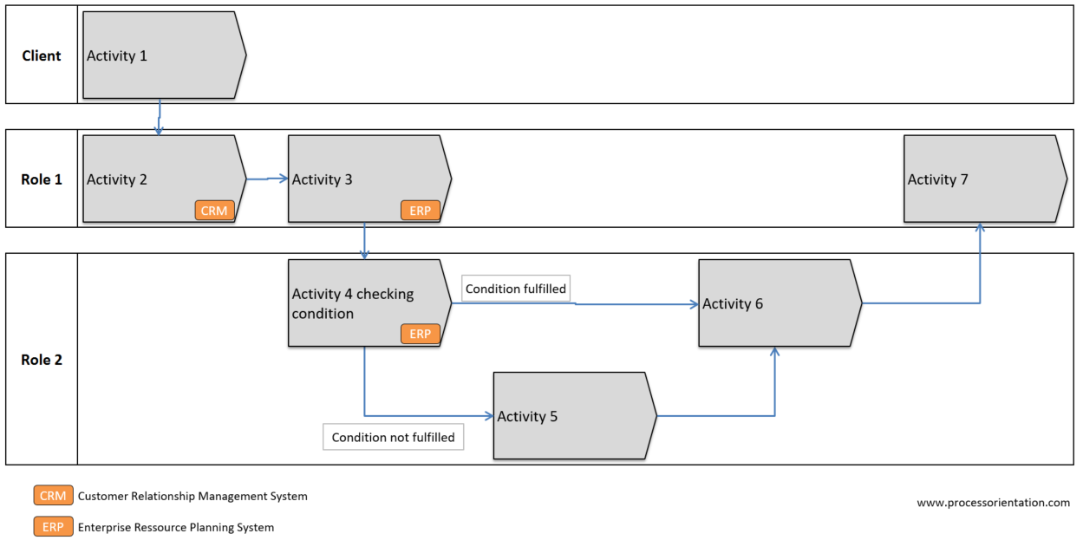
BPM – A simple example

Slide 37
Imagine that you need to help CityU’s ESU…
To do a requirements analysis of AIMS!
  Some users (staff/students) don’t like it; it needs improving
Can you use any of the tools and techniques discussed in today’s class, e.g. the BSC, BPM, SWOT, etc. to help?
  Focus on the internal process and future readiness perspective
  What are the current functions of AIMS?
    How could they be enhanced? What is not good?
    Who do you need to talk to? Questions?
  What future developments in AIMS can be imagined?
    Consider the points of view carefully

Slide 38
Work Systems
Work System Theory (WST) (Alter, 2013) provides a framework that can be used to describe how is work done in organisations
WST can be used by consultants as an instrumental theory to summarise findings and guide analysis
WST provides a common language to enable conversations among the consultants and stakeholders
WST can help consultants to demonstrate their understanding of the current situation in the organization, and thereby facilitate trust building

Slide 39
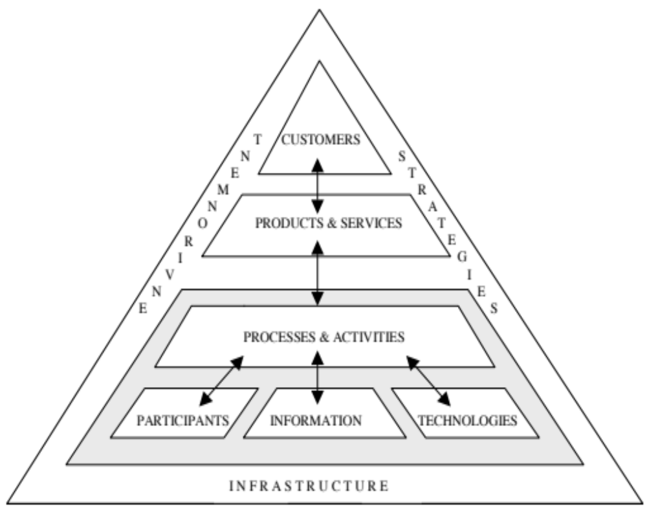
WST

Slide 40
WST Components 1
What is the purpose of the system that you are describing?
Who are the Customers of the system?
What are the Products and Services created by the system?
Who are the Participants in the system?
What Information & Knowledge is used in the system?

Slide 41
WST Components 2
What are the technologies used in the system?
What about the operating environment, including any legal restrictions, the competition and the social environment
What about the organisational infrastructure including cultural norms and local practices
What about the organisational strategy that governs how this system works?

Slide 42
Summary
In order to develop a clear understanding of a problem, we need to investigate it in detail
  We cannot trust one person to tell us the whole story
Different tools may reveal different parts of the story
  As we try to develop a holistic understanding
A better understanding should lead to a better solution
  We will look at Work Systems in more detail next week

