Slide 1
Guidelines for Week 7 Class
Each person in a group has to present at least once, either in week 7 or 13!
For week 7, please send me your ppt slides no later than 1700 on March 4th (Tuesday)
There are 12 groups, that’s 4 per hour (if there are no breaks)
So please target not presenting for more than 10 mins – to allow a little time for questions
I will preload all the ppts to the classroom computer in advance – so as to speed up the change-over time from group to group
What to present? A summary of the work that you did so far, but also include any problems where you would like feedback

Slide 2
Guidelines for Presentations 1
Have a title slide with the title and names of the students in the team
Don’t put too much content on the slides
Simplify your graphics and backgrounds
Use animations and transitions sparingly
Make sure that all the words are big enough to read – some people are far from the screen
Each presenter’s name should appear on the slide that they are presenting

Slide 3
Guidelines for Presentations 2
Know your technology
Practice: don’t read off a script
Don’t talk to the wall
Do make eye contact with the audience
Manage time carefully – if you take too much time, I will cut you off
Dress appropriately (you decide what that means)

Slide 4
Guidelines for Presentations 3
Unless you are an experienced presenter, you are likely to be nervous about presenting
You don’t need to memorize the presentation, but you do need to know what you will talk about
Rehearsing the presentation is a good idea
  And everyone needs to be involved
  Get feedback so as to make it better
Manage time carefully
On the next few slides are some bad examples – what not to do!

Slide 5

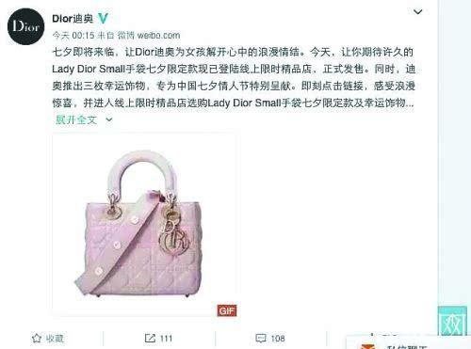
Advertisement mainly encourages the consumption through:
hearing, reading, and seeing (Zhang,2015).
The paper will discuss the seeing and reading and find the relationship with the consumption behavior.
Argument : the words and the pictures of the advertising article have the relationship with the consumption behavior
Clearer style
Has more
words

Slide 6
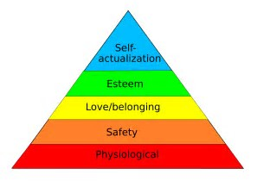

Literature Review
  Job Satisfaction (Thompson E.R. & Phua F.T.T., 2012)
  the subjective and emotive evaluation by the job holder towards the job and work context
  Needs hierarchy theory (Maslow A.H., 1943)
  e.g. Take care of family and more interactions with colleagues, etc.
Theoretical Framework (Gajendran R.S. and Harrison D.A., 2007)
3 Psychological mediators:
  Autonomy
  Work-family Conflict
  Relationship with supervisor & colleagues
Needs hierarchy theory

Slide 7
Result
Through analysis and discussing these variables, the result is pretty clear that security, time saving, user-friendly and convenience are important factors for the banking apps. When people think these four aspects are done well, they would give a high score for the apps and they would like to use the apps. Therefore, the bank can appeal to more peo ple to use the apps by promoting these four factors.

Slide 8
Discussion
Security
User-friendly
Time saving
Convenience
In this part, we used Excel to analysis and discuss our data which we have collected. We would find the importance of security, convenient and other several factors for the banking apps by using Regression analysis. Regression analysis refers to a statistical analysis method for determining quantitative relationships between two or more variables.

Slide 9
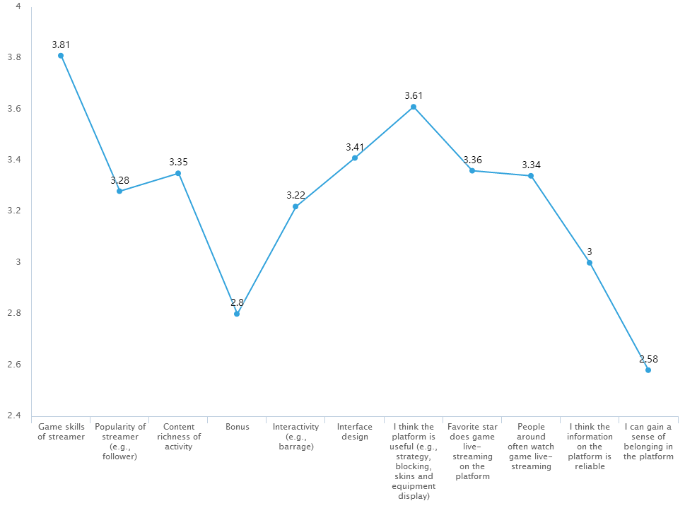
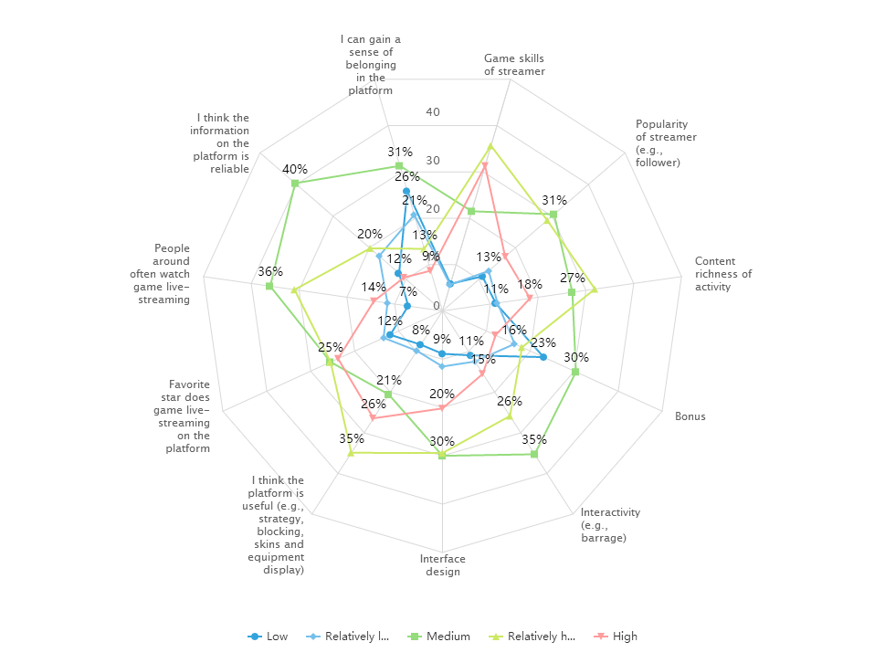
Descriptive statistics report
Influence factors of e-sport game players’ selection on live streaming platform

Slide 10
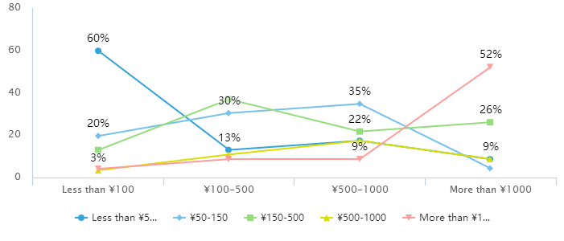
Cross-over analysis
Monthly cost on live streaming platforms and Monthly cost on e-sport games

Slide 11
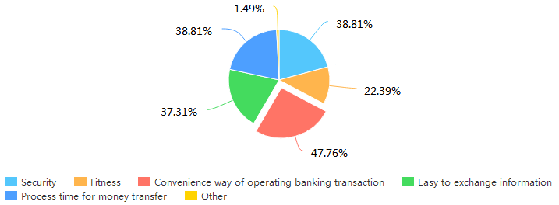
Data Collection and Analysis

Slide 12
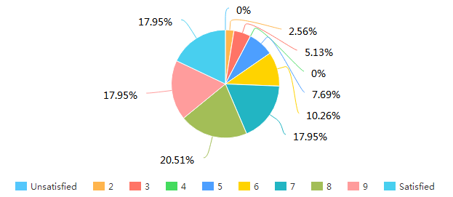
online banking analysiss
Please rate for online bank —— Convenient

Slide 13
different Perspectives

Slide 14
Different perspectives

Slide 15
Don’t Worry!
The presentations should be fun and we, the audience, should enjoy them
I hope that there will be a little time after each presentation to ask questions
  I will have 1-2 questions for each group, but everyone in the audience is also invited to ask questions, or offer comments/suggestions
  This is not a zero-sum game. There are no winners and losers.
When I teach, I walk around – that’s allowed for you too!

