Slide 1
FB5003 - 3
Knowledge Management & Knowledge Mapping

Slide 2
“
“The world doesn’t care what you know. The world cares about what you can do with what you know.”
Tony Wagner, co-author of Creating Innovators (Wagner and Compton 2015)
“To know things you have to grow into them, and let them grow in you, so that they become a part of who you are” (Ingold, 2013)
“We do not obtain knowledge by standing outside the world, we know because we are of the world” (Barad, 2007)

Slide 3
Basics
Knowledge is
  Information that is contextual, experiential, relevant, and recontextualisable for action taking
  A representation of skilled practices
Knowledge can be
  Tacit and hidden or explicit and communicated
  Operational and in use or strategic and in mind
  Emergent & dynamic or static & immutable
Knowledge varies with culture and context

Slide 4
Questions
Why is knowledge important?
What can we do with it?
Can we share it with others?
How do we make sense of others’ knowledge?
Why do we need to manage it?
Is it possible to teach knowledge?
How can we live with knowledge?

Slide 5
Scenario 1
I have been searching for a solution to a problem all day. Eventually, I find the answer on a website – and the author is … my colleague from two-doors away down the corridor!
Why didn’t I know?

Slide 6
Scenario 2
I am the senior partner of a global headhunting firm. We have reasonable information management (industry analysis, market research, resumé databases) but do nothing to tap into the vast knowledge resources held in the brains of our consultants. Each time a consultant leaves, our firm’s collective brain is drained.
What can I do to manage our knowledge resources better?

Slide 7
Scenario 3
In my team-based work environment, none of my immediate colleagues can help me.
  The corporate knowledge base is out of date (as usual)! No one ever wastes time on that!
So, I jump over the corporate firewall and ask my external friends
  In fact, I ask 15 of them!
In minutes, I have several good answers
  And 3 minutes later, one of those friends asks me for help
What’s going on here?

Slide 8
Application Contexts
What is the knowledge difference between?
  I know how to ride a bicycle, drive a car
  I tell you how to ride a bicycle, drive a car
How is knowledge different from information?
Can I just give you my knowledge?

Slide 9


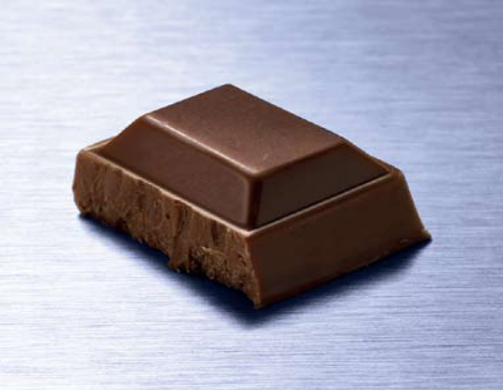
We All See and Make Sense of The World in Different Ways
Useful or Useless?
Useful or Useless?
Energy?
Pleasure?
Romance?
knowledge
Knowledge?
Adapted from HSBC

Slide 10
Knowledge and Sensemaking
Making sense of reality - problems and people - is a critical aspect of life.
Each of us makes a different sense of a situation.
Making sense, individually or collectively, requires information and knowledge transfer, debate, and analysis of cause-effect relationships, drivers and consequences.
Sharing knowledge without trying to make sense of it seems pointless
Thinking about knowledge without a context where that knowledge is relevant also seems pointless, ridiculous

Slide 11
So … Sensemaking
… is the act of creating meaning out of a mess of unstructured data, information and knowledge.
Not just finding answers to problems but understanding why there is a problem.
And analysing how a problem can be avoided next time
Is it easier to do this alone, or together?
Great Minds Think Alike or Clever Minds Think Together?

Slide 12
Conversation Enhances Sensemaking
By engaging in conversation, so we share our ideas, listen to others, make sense of information in the world
This helps us to make better decisions and to avoid too much subjectivity
But a conversation is not a monologue
  It needs all stakeholders to communicate together!
  And the conversation must take place in a context that gives the shared experience meaning
  Those who participate in the conversation are with each other as they explore and learn

Slide 13
Conversation Requires Questions
Why didn’t I know?
  Because I didn’t ask?
  Because no one told me - and no one knew that I didn’t know?
  Because I didn’t know that others didn’t know that I didn’t know?!
So, we (need to) ask and answer questions
  Sharing together
Conversation is central to human communication and understanding.

Slide 14
Barriers to Sharing
People often resist sharing
They think that it is ‘my’ knowledge
  Even though they usually created it with others
They can be selfish, locking their knowledge away from others
  So, others won’t share with them either
  No conversation, no feedback, no validity

Slide 15
Sharing, Nature and Work
Is it natural to share?
  How do we feel comfortable to share?
  Who do we want to share with?
  How much control do we want to have over our ‘own’ knowledge – i.e. who can acquire it?
  Sharing can be easier in communities
Which technologies might facilitate the natural intimacy of conversation?

Slide 16
Organisations Try to Manage Knowledge to Address Objectives Like:
Improving performance, innovation and competitive advantage
Sharing lessons learned & valuable insights
Ensuring continuous improvement
Reducing redundant work
Avoiding the re-creation of old knowledge
Minimizing training time for new employees
Retaining intellectual capital due to employee turnover

Slide 17
Systematic Knowledge Processes
Does a firm have systematic processes for
  Capturing, organizing, sharing & discarding
    External and Internal knowledge?
Are there processes for enhancing knowledge creation and innovation?
Are there procedures governing the protection of knowledge assets?
Does senior management actively promote and engage in a knowledge sharing culture?
Are knowledge contributions measured or linked to financial performance indicators?

Slide 18
Knowledge and Privacy
http://www.aclu.org/ordering-pizza
https://www.youtube.com/watch?v=H1iajbOW4iQ
What kind of knowledge can we see here?
How is this knowledge used for decision making?
What are the exact privacy concerns?
Do you feel empathy for the customer or the service operator? Who is learning here?

Slide 19
Rewarding Knowledge
Both creators and users of knowledge should be rewarded.
Mistakes are also a source of knowledge – so reward their reporting
Knowledge sharing should be recognised financially and publically
Failure to use/share knowledge should be penalised
Rewards can be designed at both individual and team levels
Time must be allocated to knowledge creation and sharing.

Slide 20
Siemens – ShareNet 1
Siemens worldwide adoption of KM
Strong German Organisational culture
Sophisticated reward point system
  Redeemable for gifts, trips, etc.
Strong sense of employee involvement
  More for kudos than rewards
Active answering of questions raised by others

Slide 21
Siemens ShareNet 2
An Italian office of Siemens was looking for information that would help in a project bid.
They found the information on ShareNet
  The knowledge had been created by Chinese employees.
Siemens got the project
  And rewarded those who created the knowledge.
Overall, ShareNet helped Siemens gain €120M of projects

Slide 22
Siemens ShareNet 3
Actually, Siemens’ Chinese employees did not like contributing to ShareNet very much.
They preferred to share within their guanxi-linked in-groups.
  Private not Public Conversations!
Even though the strong German culture expected that knowledge would be public
  So culture is important

Slide 23
Knowledge Practices in China
I consulted on knowledge-focused projects in several private companies in China
Public Relations
  Eastwei
  Ruder Finn Asia
Hospitality (Hotels)
  Franchises within the Accor Properties Group: Sofitel, Novotel, Mercure, …
  In BJ, SH, CD, CQ, SZ, HK, WH, MO, GZ
Software Developers (mostly in Beijing)
  iSoftStone, ThoughtWorks, Glodon, …
Logistics - Fedex

Slide 24
Sources of Evidence
Interviews
Discussions
Participant Observation
Training Workshops
Content Analysis of IM logs

Slide 25
Four Key “Themes” Emerge
The Nature of Knowledge
  Seeking and sharing knowledge
Transactive Memory
  Relying on other people for specific knowledge
Guanxi
  Reciprocal Obligations
The Role of Interactive IT Applications
  Especially Social Media

Slide 26
Knowledge Seeking & Sharing
Employees have a strong preference for one-to-one or within-team knowledge seeking & sharing
  “Knowledge sharing means ensuring that the resources are available for the whole team”
  “My method [of knowledge sharing] is to tell people my personal lessons and experiences when I know others meet similar situations. My aim is to prevent people from repeating my mistakes”.
  “If I need to get some media contacts which I do not have, I ask the other teams one by one. The [corporate intranet] system is there, but nobody maintains or updates it”

Slide 27
Transactive Memories
“Some members are good at media relations, [others] know the product features well or have a better understanding of the dynamic information of the whole industry. Thus, every member can best use their expertise and the quality of the service [provided by the team] will be improved”
Where internal colleagues can’t help, they turn to external networks
  “I had to ask my friends in the media industry to help me”

Slide 28
Transactive Memories
“I do rely on other people to remember things for me”
“If my friends can’t help me, they may ask their friends, but I won’t develop guanxi with that person”
“If a person with whom I have close guanxi asks for help, I must help”
“I have experts within my in-groups – for gifts, media, printing”

Slide 29
Guanxi
Employees are expected both to bring guanxi with them when they enter the firm and to develop new guanxi.
Employees are headhunted because of their access to networks - guanxi (CEO)
  “Guanxi is arguably a media firm’s most valuable asset”. “If you don’t have good guanxi, what are you doing in the PR industry?” (CEO)
  “Without guanxi, I can’t work”
  “I am not allowed to use IM at work, and my guanxi network has suffered in consequence. It is harder to work effectively.”

Slide 30
Guanxi
Guanxi is notable for its obligatory reciprocity
  This may lead to knowledge outflows and loss of IP
Guanxi does not work well outside the ingroup
  “There is a lack of intra-office, cross-team communication”
  “I work for the consumer team and I may need a contact that is available in the auto team. But there is little daily communication between teams, so we can hardly know others and get their help”
  “I prefer to develop external guanxi with people from my hometown who speak the same dialect and share the same values”

Slide 31
Interactive IT Applications
Employees make continuous use of a number of IT applications, esp. social media
Extensive lists of ‘friends’ or ‘contacts’.
  As many as 700, structured by category
  Multiple simultaneous chats
  Interrupting work, but *not* reducing productivity
  Content analysis shows 80% work related
“SM is especially valuable for urgent conversations”.

Slide 32
Interactive IT Applications
“Social Media is part of life. We can’t block it. But we hope to encourage employees to use it responsibly”
“We operate a totally open IT policy. Any application is allowed. We just gave complimentary iPhones to all employees – for work”

Slide 33
Leveraging Effects
Employees leveraged both guanxi and IM tools in order to seek and share knowledge, so as to solve problems on-the-fly as a form of “rapid, ad hoc collaboration”, without recourse to centrally managed intranet-based KMS
Interactive conversations were more powerful drivers of value than IT – because they leveraged guanxi!

Slide 34
Conversations and Knowledge
Social computing enables us to regain the conversation in our work
  The conversation is critical, as the knowledge is embedded into a live context that serves to explain and illustrate how the knowledge is applied
Knowledge that is distilled, squeezed, extracted out of stories is much less useful!
Einstein: “Imagination is more important than knowledge”

Slide 35
Imagination and Mental Space
It is easy to tell people to be imaginative and creative, but it is harder to make it happen
Some organisations encourage their employees to use office time for free-thinking (imagination, creativity) alone or together
  Google – 20%; 3M – 15%
These companies hope that new product ideas will emerge from this unrestricted time
What about universities?

Slide 36
Six Principles of Knowledge
Knowledge sharing is better when it is voluntary
Knowledge is valid in a context
Knowledge is best communicated through conversation not codification
All knowledge is fragmented across people, sources
What we know and how we report what we know are different
Who you know is just as important as what you know

Slide 37
1. Knowledge is Voluntary
Knowledge cannot be conscripted
  You can’t force people to share (useful) knowledge
    If you try to, the quality will be variable/unreliable and the people may be very unhappy
  So, knowledge must be offered freely
Better still, knowledge is offered unconsciously as a natural component of organisational life and culture

Slide 38
2. Knowledge is Valid in a Context
All knowledge has a context, and it is valid in that context
The context incorporates space, time and human elements
Can we transfer knowledge across contexts?
Can we recontextualize knowledge?

Slide 39
3. Conversation not Codification
KM techniques have shifted
  Collection > Connection > Conversation
Conversation is seen as more valid because
  It preserves the (live) narrative context wherein knowledge has validity
  It enables a focus on networks of people (and guanxi), not the knowledge itself
  Conversation implies not simplex, unidirectional sharing but a duplex, two-way, meeting of minds: a creative and learning process

Slide 40
4. Knowledge is Fragmented
In our brains, knowledge is scattered across memories
  Our brains process, integrate and blend these scattered fragments into new forms when we need it
  A KMS is likely to be much less sophisticated than a human brain, so its capability to process in human-like ways is greatly restricted.
  Conversations involve not only sharing, but also creation: new knowledge is created out of shared experiences and discussion
Can AI help to reduce the fragmentation and increase the integration?

Slide 41
5. What we Know is not how we Report what we Know
Our brains are good at blending
  Heuristics
  Pattern-matching
  Extrapolation (and Interpolation)
  Previously successful techniques
  Experiences (Knowledge)
…in nano seconds.
But if you ask someone to write down how s/he reached a decision, ….
So, how accurate and complete will a written account of knowledge be?

Slide 42
6. Who You Know is Also Important
If you know, and have access to, knowledgeable people, you may be able to access their knowledge
  Transactive Memory
Having a good network – of people who are experts in different areas and heterogeneous to each other – can be a valuable resource
“I want to hire this lady because of her network of contacts, her guanxi with others. These external people will also help our company”

Slide 43
New Knowledge Tools
Strategic Knowledge Expert Network Maps
  Formalised by 3M as a way of identifying who knows what and where people are located
  Used as a way to identify
    Organisational strengths and weaknesses
      particularly after a merger/acquisition process
    Redundancies, opportunities and vulnerabilities
  More obviously relevant to larger organisations
  A number of analyses possible
  This is meta knowledge: knowledge about knowledge

Slide 44
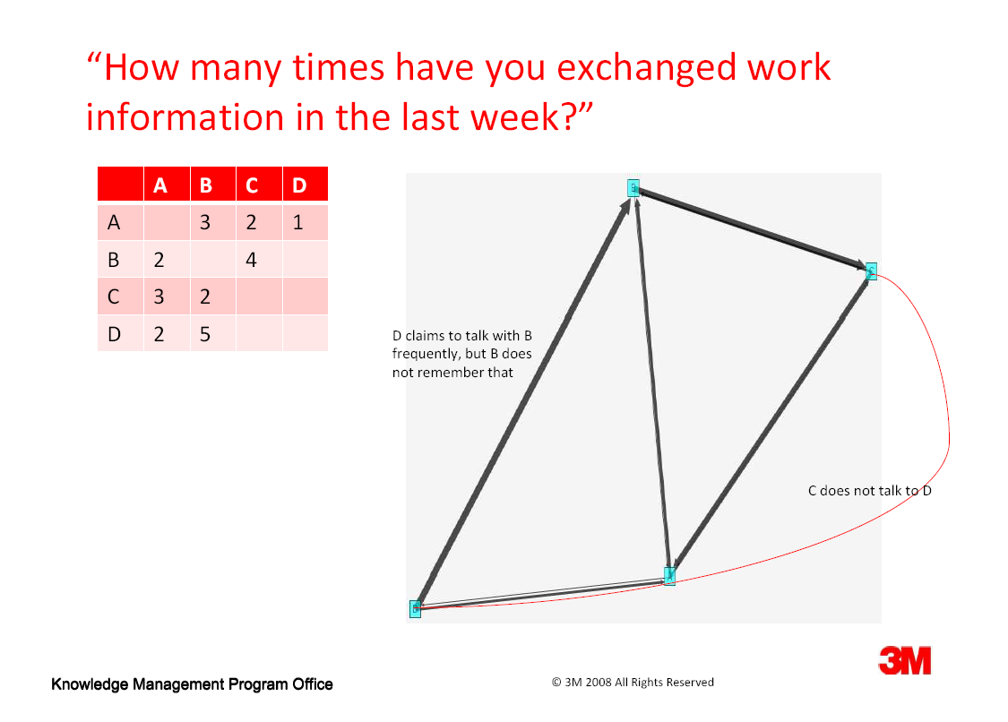
A Simple Example,…
B
C
D
A

Slide 45
Network Centrality
How central are you (or is your unit) in the organisation? How integrated?
  Who do you talk to? Who talks to you?
  How often? What about?
  How many opportunities are there to learn from others – through conversation?
  Cross-pollination of ideas >> innovation!
Individuals (or units) with a high “index centrality score” may be in a better position to learn, to acquire intellectual resources.

Slide 46
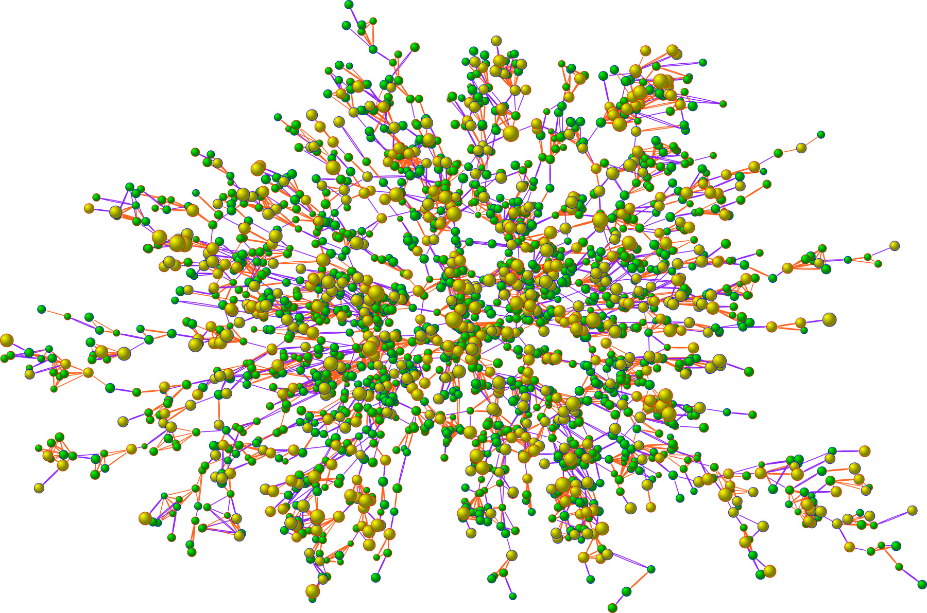
Who is at the centre? Who is connected to whom?

Slide 47
The Theory of Weak Ties
Is it more useful to receive ideas from people you don’t know – because it is more likely that they know things that you don’t?
  You can learn more
Sounds nice, but it is almost the opposite of guanxi – where people prefer to share with and receive from others with whom they have a strong relationship.
  Even though you may learn less

Slide 48
Weak or Strong Ties: Which are Better for Valuable Knowledge Exchange?
Do we acquire more useful/unique knowledge from people with whom
  We have closer relationships?
  We trust more?
  We share knowledge regularly?
Or from people with whom:
  We are more distant?
  We seldom contact?
  We share little in terms of day to day work?

Slide 49
Balancing Guanxi and Weak Ties
Can they be balanced? How?
Is there room for compromise?
Can you develop guanxi with weakly-tied people?
People you may never meet?
People with whom you have nothing in common – except the desire to learn?

Slide 50
Tie Strength and Knowledge
Strong
Strong Ties and Useful Knowledge
Chinese Theory of Strong Ties
Tie Strength
American Theory of Weak Ties
Weak Ties and Useful Knowledge
Weak
High
Knowledge Usefulness
Low

Slide 51
3M
3M has over 60,000 products in a wide variety of areas
  Abrasives, laminates and adhesives,
  Medical care and biotechnology,
  Solar energy and mining, Fire Protection
  Electricity and drug delivery,
  Light management and acoustics
These are all different, yet can they be combined?

Slide 52
Knowledge & Innovation
“Innovation is a must to survive in our environment.…All of my [executive] colleagues understand the need for innovation and are 100% supportive of employees who innovate.…Yet, I cannot say that we have an organizational process for innovation… Innovation happens, but I cannot outline the process to you because I do not think we have one.”
  CEO, Information Technology Organization

Slide 53
Innovation
However, innovation can be stimulated through the cross-pollination of ideas…
  Getting people who don’t work in the same areas to talk to each other
  Getting them to be creative
  Assessing their ‘risky’ ideas
  Identifying possible new products that combine knowledge from different areas

Slide 54
The Critical Role of Boundary Spanners
People who either
  Have knowledge that crosses topic or organisational boundaries
Or
  Know people located on the other side of a boundary
Such ‘boundary spanners’ are extremely valuable because they enable new learning activities, new product development, new innovation and creativity
However, the ‘trick’ is to know what to do with boundary spanning…

Slide 55
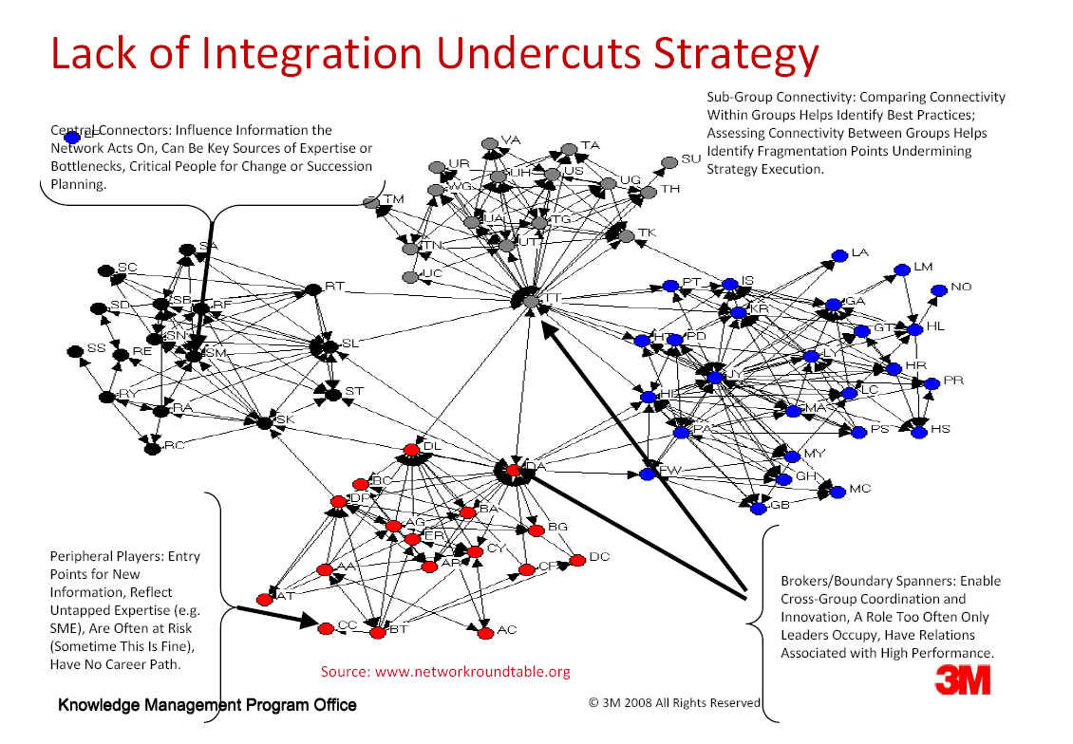

Slide 56
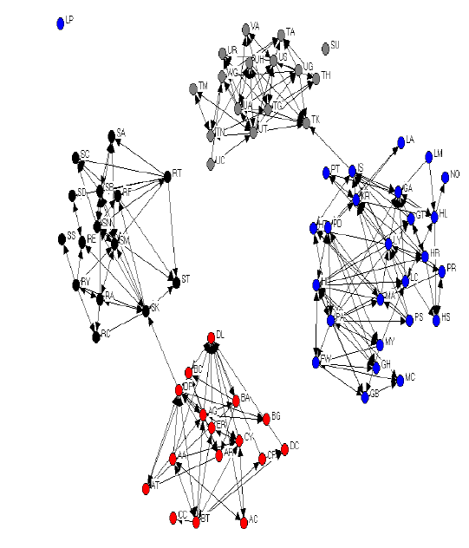
Connectivity & Integration Fails without Effective Site Leaders and Leader-Networks

Slide 57
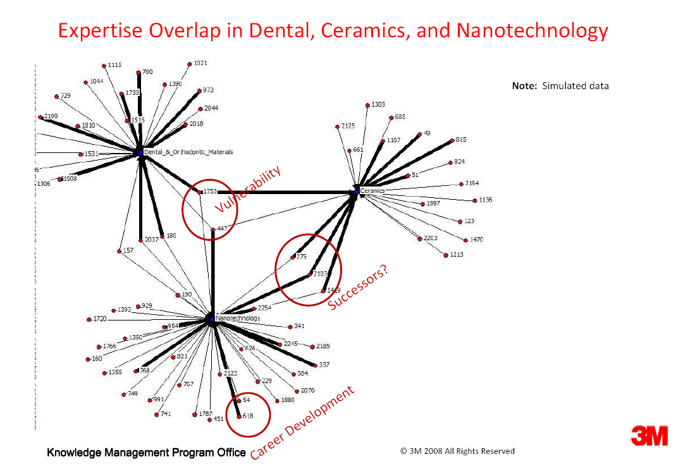

Slide 58
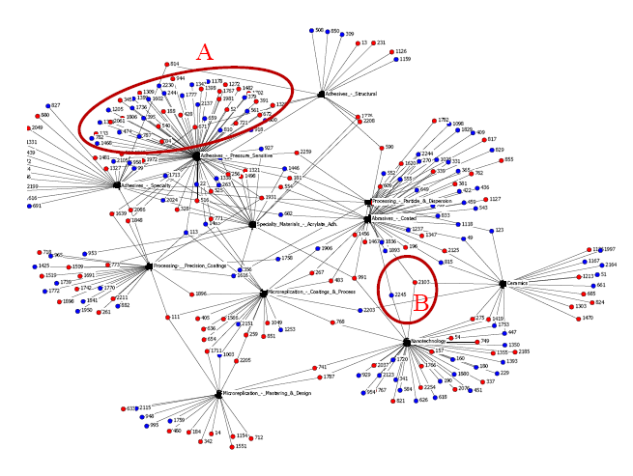
Post-acquisition Knowledge Integration
A bird’s eye view of skills and knowledge inventory
  Easy identification of knowledge overlaps (A)
  Opportunity to leverage knowledge synergies (B) by connecting people who may not know about each other
  Align human resources and business needs across a combined enterprise

Slide 59
New Product Opportunity???
Adhesive Technologies
  Sticky – but non-sticky
  Sterile and hygienic
Medical Technologies
  Bandages
  Non- drip, leak, abrasive
Materials Technology
  Absorptive
  Self-dissolving

Slide 60
Ownership & Motivation
At 3M, new products that evolve as a result of the research by the department belong to the division
New technologies that are developed belong to the company as a whole.
Motivation is seen as a critical enabler of innovation: if the employees don’t care, they won’t bother to try to create new ideas and products
A flat organisational structure also helps – minimize the bureaucracy

Slide 61
What You Can Imagine, You Can Achieve
Einstein:
  “The significant problems we have cannot be solved at the same level of thinking with which we created them”.
So, how do we reach a new level of thinking?
One way is through mental experimentation, brainstorming, conversation – between experts from different topics – just as 3M is trying to do.
Imagination is the Boundary of Possibility

Slide 62
Integration, Learning & Capacity
Much of 3M’s focus has been on network analysis.
  Who is where, who talks to whom, who is / not connected, where are the mismatches.
  There may even be an (invalid) assumption that network positioning is all that matters.
  But what about the ability of individual people to learn, to develop new skills, to engage in experiences and acquire knowledge?
    Could we measure that too, and map it? Implications?

Slide 63
Matrix Analysis (Individual)
Skill & Level | Creativity | Negotiation | Product Development | Project Management
Basic |  |  |  | X
Medium |  |  | X | X
Advanced |  | X | X
Expert | X

Slide 64
Turnover, Retention and Succession
Who are the top 5% of people whose knowledge (if not bodies) we must retain?
    What knowledge do they have?
    With whom do they work?
    Can we ‘develop’ other ‘nearby’ people so as to reduce reliance on them?
Who are the quick learners?
    We also want to retain them, promote them, and get them to network with critical others.

Slide 65
Serendipity by Design: Exospect
Roberto Evaristo used to be the Global KM Leader and Senior Manager for Corporate Strategy at 3M
Later, he started his own consulting company called Exospect
Here, the focus is on strategic resource mapping - connecting people and networks across the enterprise and partner ecosystem
Applications in the gig economy? Product team formation? Heterogeneous teams?
https://www.linkedin.com/in/robertoevaristo/

Slide 66
Strategic Resource Management
Assess the extent to which we have coverage in the following aspects
  Geographical, Product, Functional
Do we have the knowledge resources to create a new product?
  Could we sell it to a new customer?
  What resources do we need?
  How could we develop them?
    Internal development or external hiring/headhunting?

Slide 67
Problems with this Technique
Which topics should we focus on?
How fine a degree of granularity of knowledge do we want to represent?
Can we collect all the necessary data to make this strategic mapping possible?
Will top management champion this new idea, this new way of representing knowledge?
Is it too transparent?
Are individuals too empowered to search for new opportunities – loss of central control?

Slide 68
Discussion – Bob’s Story
What kind of work does Bob do?
What are his knowledge tools (in 2004) – and which different tools might he use today?
Which skills and characteristics does Bob need to have to work? Any updates for today?
What value does he bring to the company?
  How could we measure the value Bob brings?
Bob’s context is limited to one country (US). How would his work change in a global sphere of operations?

